Slide 1

Group 17 Level 4-5 Group Project.
Ross warren, Reece page, Darren wright & Razvan Muresan Bardos.

Slide 2
Boredom Warrior.
The monotonous job and dull life you have is draining, there is only one thing you truly look forward to life, going home and playing a new video game in a CyberPunk 80’s world becoming, the boredom warrior.
RW

Slide 3
Concept of the game.
2D sidescroller and rhythm game.
Two separate worlds.
Fight enemies, run fast, jump, file papers, drink coffee and type.
RW

Slide 4
Rukkenrunruhe and onism.
What emotions does onism generate?
Trapped
Helpless
Confined
Frustrated
But in a way also motivated to want to do more.
What emotions does Rukkenrunruhe generate?
Sadness
Anger
Trapped
Frustrated
Regret
RMB

Slide 5
Research into target demographic and style.
Men between 16 – 30.
Colour pallets of Pinks, Blues and silvers. And whites and greys.
Ways of eliciting the chosen emotions.
DW

Slide 6
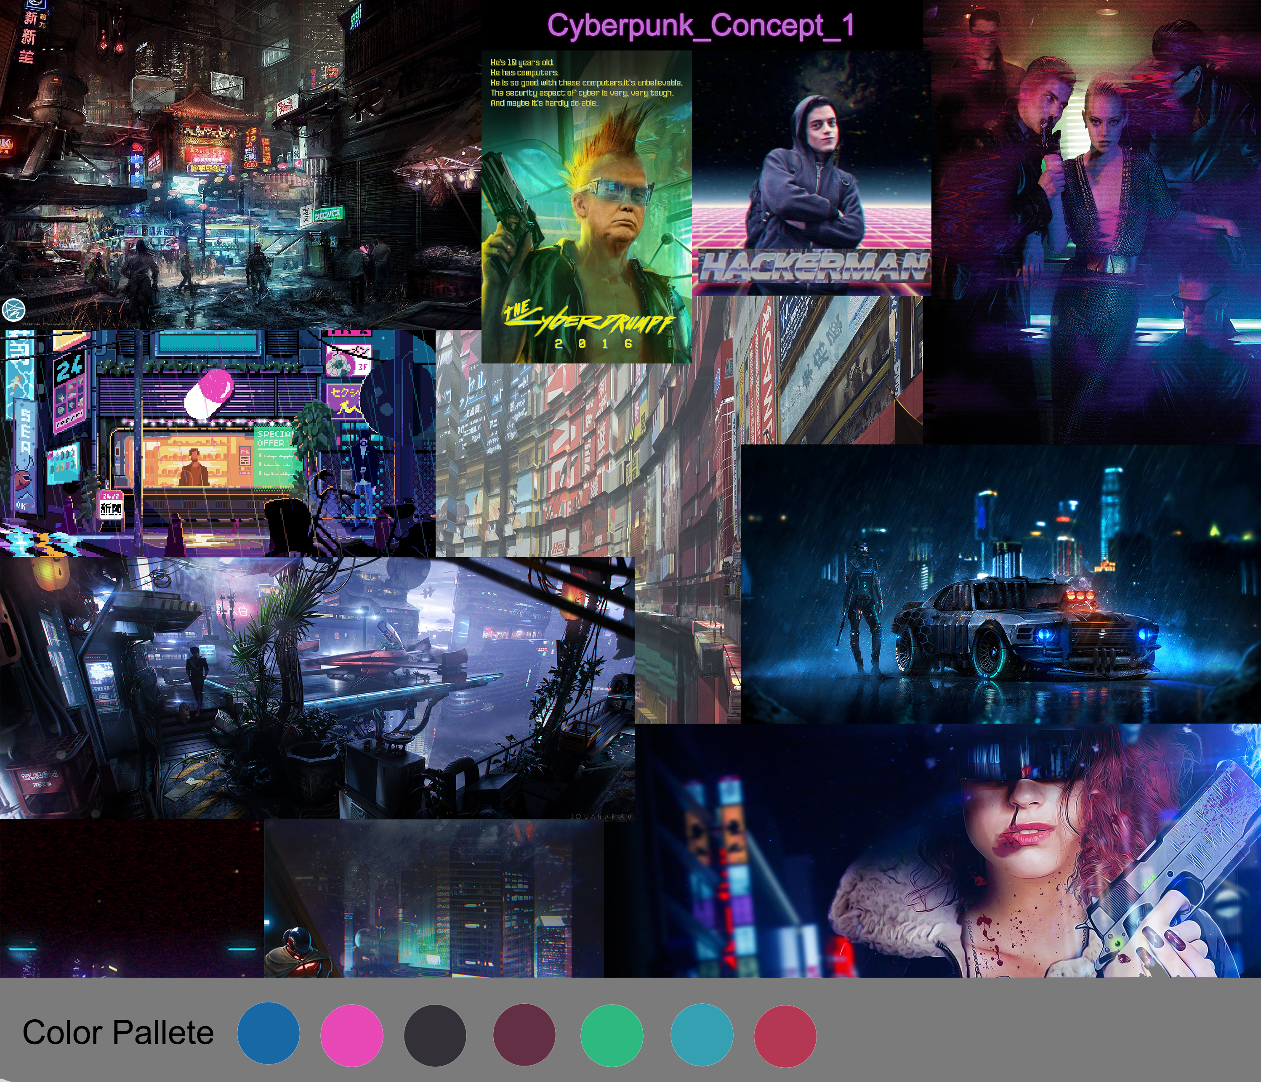
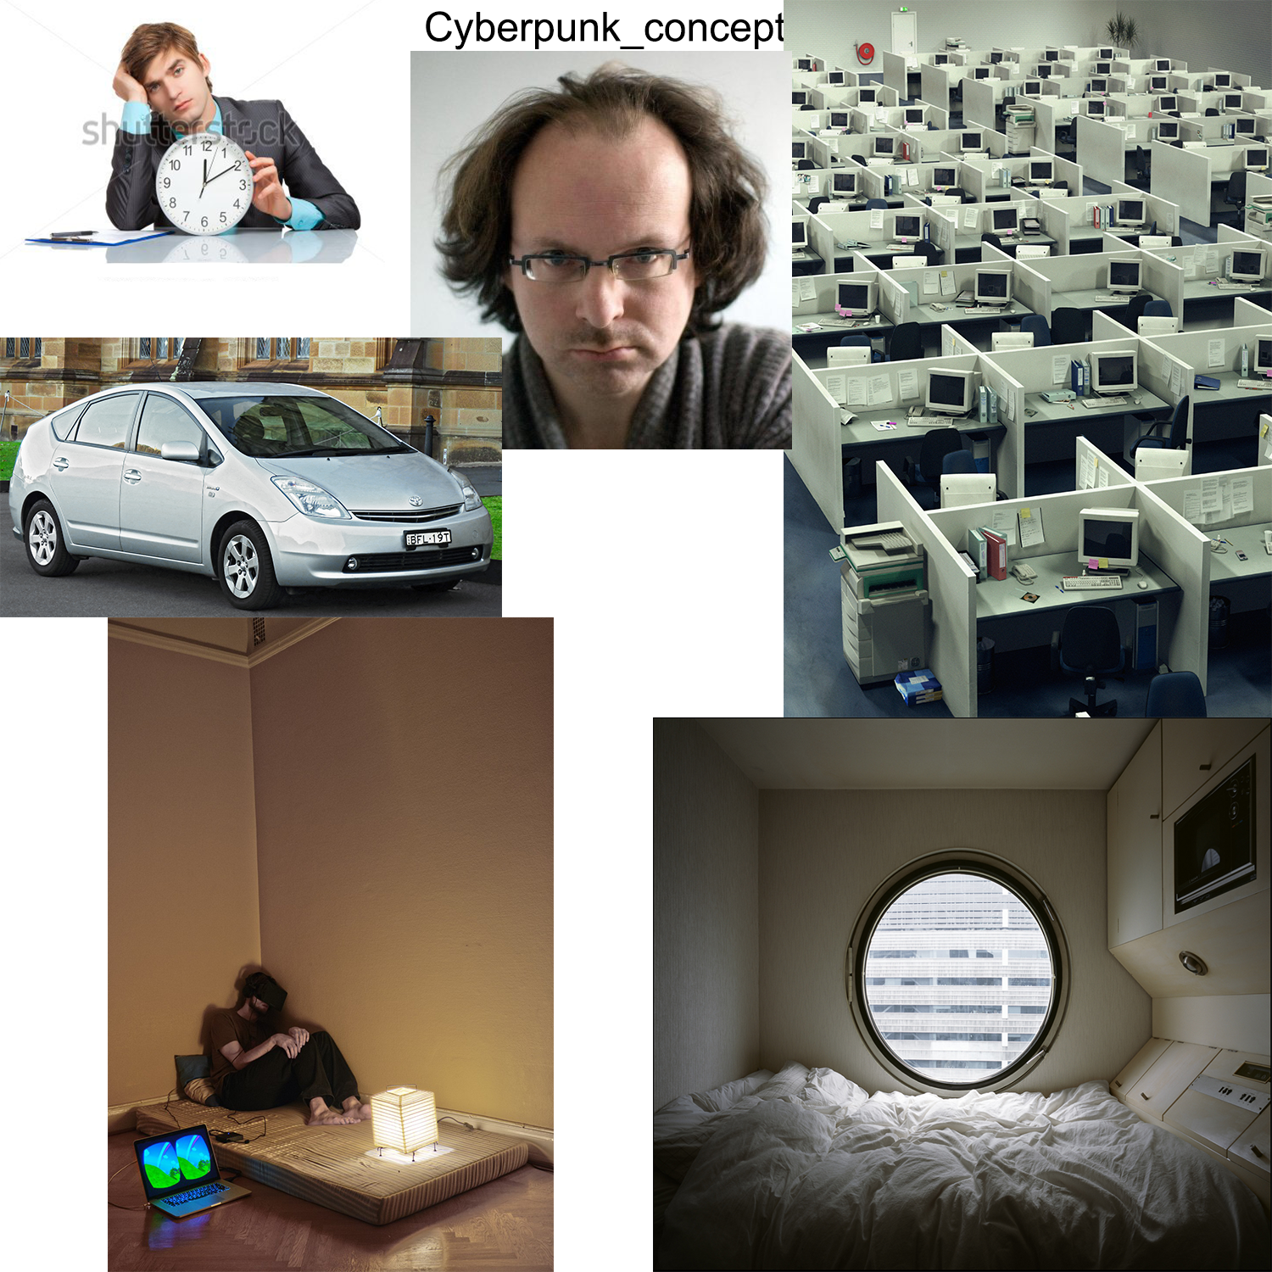
Moodboards.
RMB

Slide 7

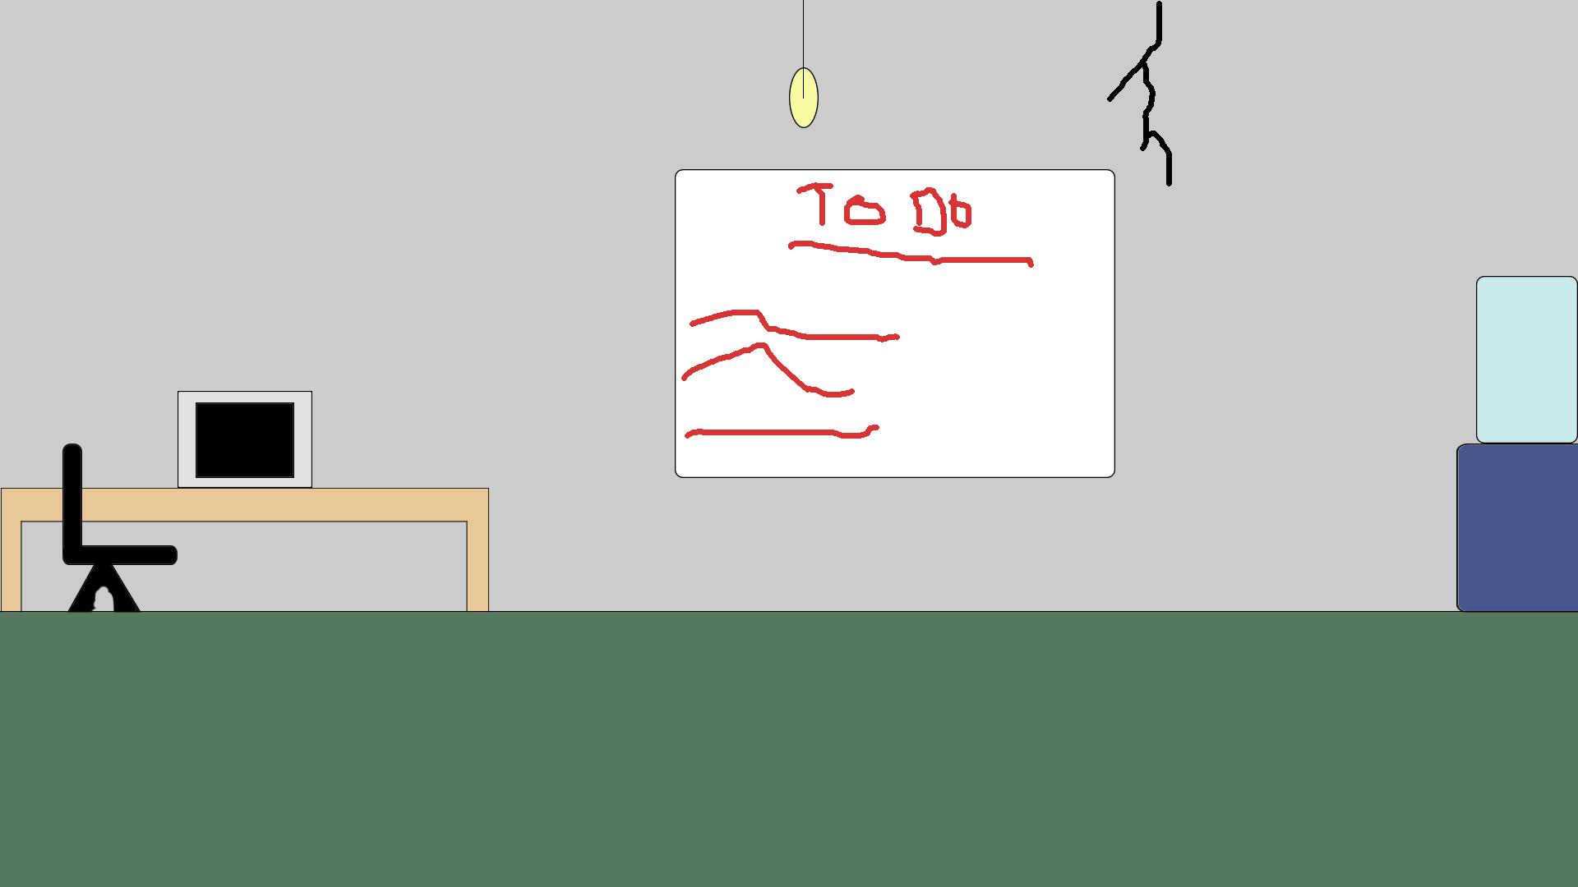
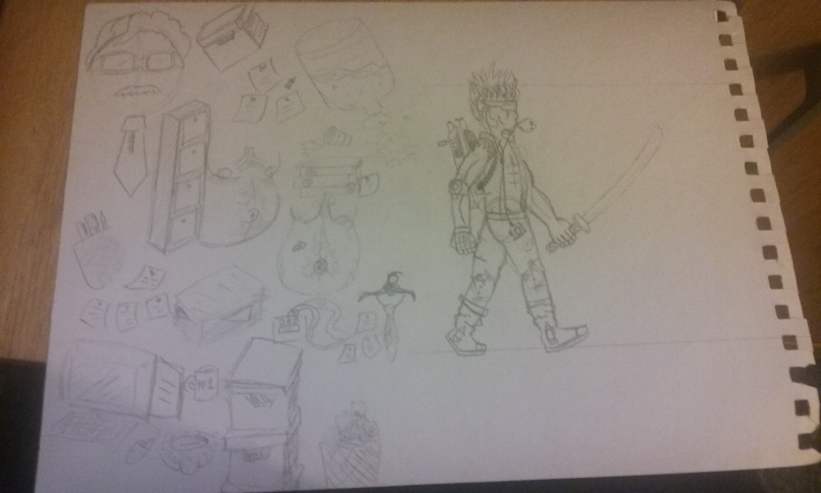
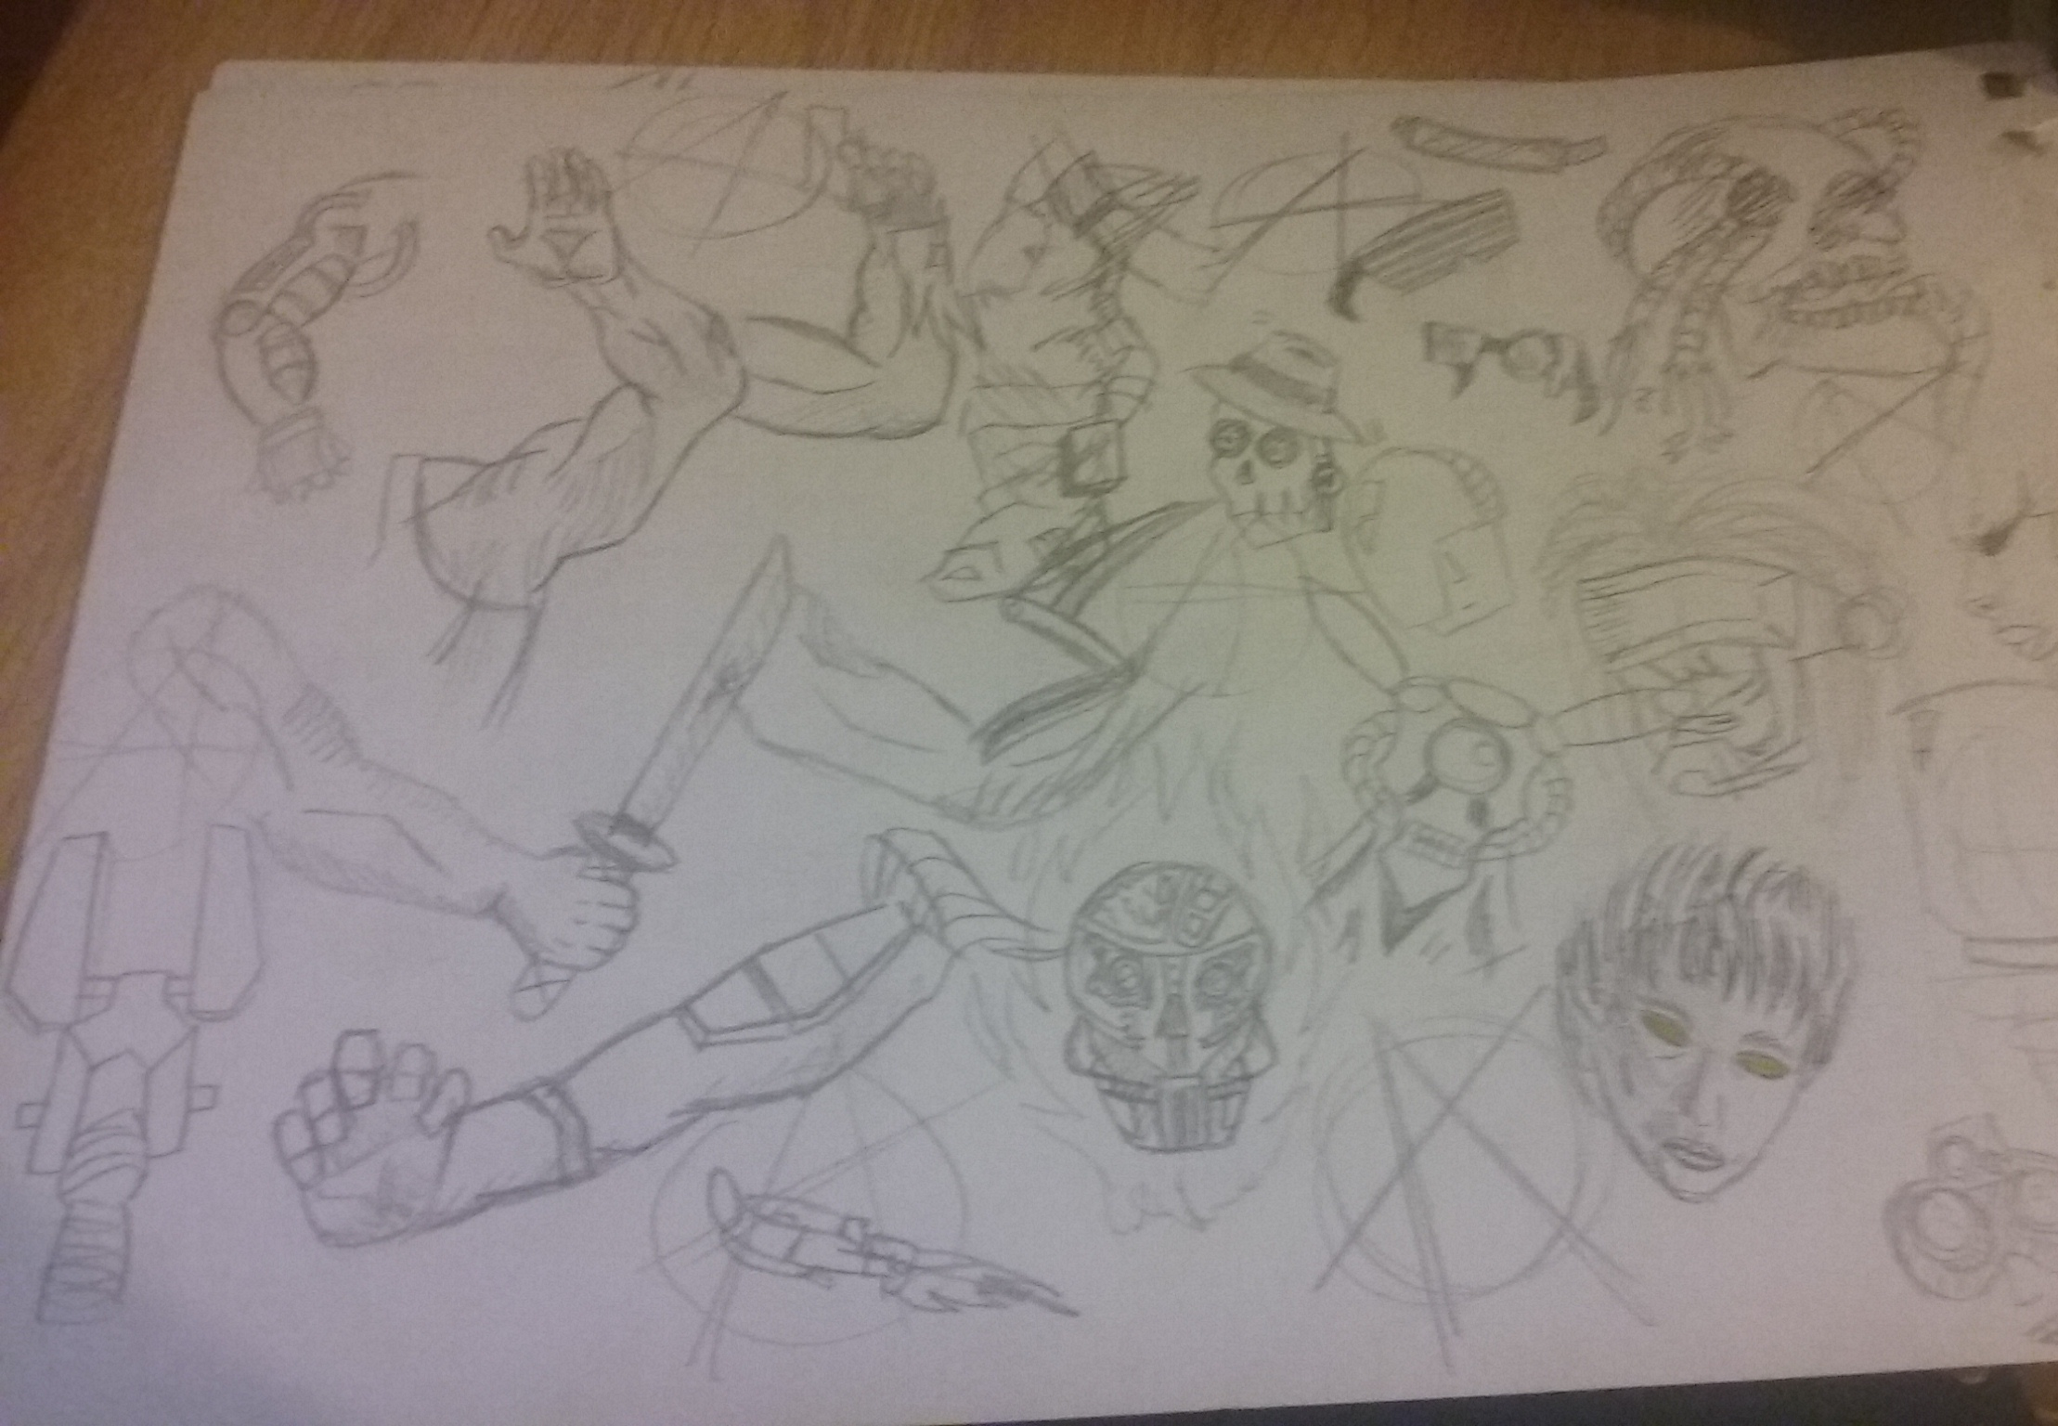
Concept art.
DW

Slide 8
Github & emails.
Emails
Week One.
Reece; 17.
Ross; 15.
Darren; 11.
Razvan; 14
Week Two.
Reece; 9.
Ross; 18.
Darren; 6.
Razvan; 3.
RW

Slide 9
Any questions?

